Slide 1
An Introduction Web Development and Django

Slide 2
Agenda
Introduction
Basic Web – HTML and CSS
The Dynamic Web – Introduce languages and databases to support transactions
What are Model-View-Controller and a Model View Frameworks?
Your Web Development Environment
Web Development Environment
Web Integration
Django
Agenda

Slide 3
The amazing HTTP and HTTPS
A protocol used to transport Web pages (which includes different sorts of objects) from one node to another
Developed at the CERN (Geneva, Switzerland)
Designed to set up & tear down connections quickly & efficiently
HTTP is a “stateless protocol” – Does not need to maintain session information with clients and server
Shortcomings Of The Basic Web
Notes:
Each access to an object, be it an html file, an image, or whatever, involves a separate connection. This can be good in most cases, for when a user clicks on a link

Slide 4
HTTP
Typical HTTP Session
Connect
Request
Response
Close
Request commands
GET
GET homecr.htm HTTP/1.0
HEAD
POST
PUT
DELETE
HTTP is very light-weight, fast.
Shortcomings Of The Basic Web
Notes:
A request message consists of a universal resource identifier (what is requested), a request method (five listed here), protocol version, request modifiers, client information, and possible body contents.
GET. Most commonly used and indicates the document to be fetched.
HEAD. Used just for meta data (headers) without transferring the entire document.
POST. Method used for sending messages that can be posted, also, as we’ll see, for send content that the user has entered.
PUT. Places the enclosed entity at a URI location. This method is used to transfer documents to a Web server.
DELETE. Deletes the resources at a URI

Slide 5
The Basic Web
Inter(-tra)net
Browser
Display of static HTML
Platform independence Multiple media Point & Click (easy)
Protocol
HTTP over TCP/IP
Simple & light
Stateless
Server
Fast file server
The Basic Web is excellent for what it was designed for: Universal, easy access to simple, static information.
It is not well suited for what it was not designed for:
Industrial strength, mission-critical applications.
What’s missing?
Notes:
What are the short comings of the basic web?

Slide 6
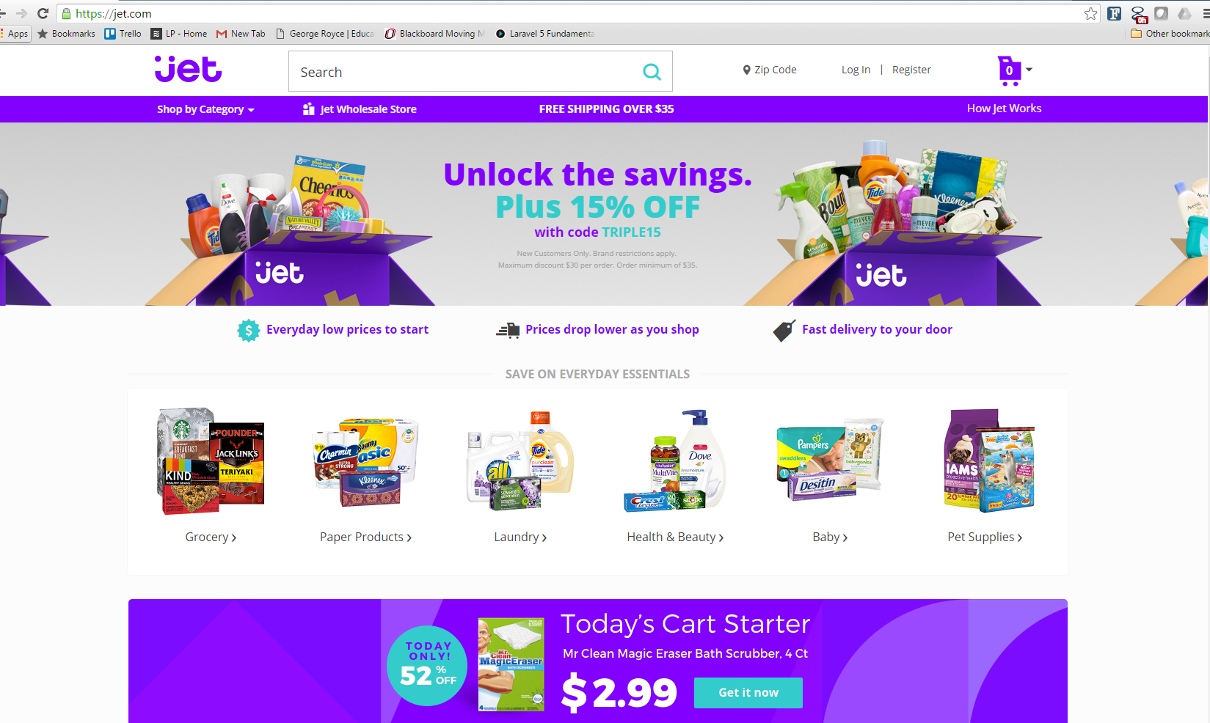
What controls websites and many mobile applications?
HTML | CSS | JavaScript | Python, PHP, Java, NodeJS, Ruby | Databases
Hypertext Markup Language - controls document structure | Cascading Style Sheets – controls the look and feel | JavaScript controls behavior within the Client Browser | Server Side Languages control process, calculation, server-side business logic | Databases like MySQl, PostgreSQL, MongoDB store the content

Slide 7
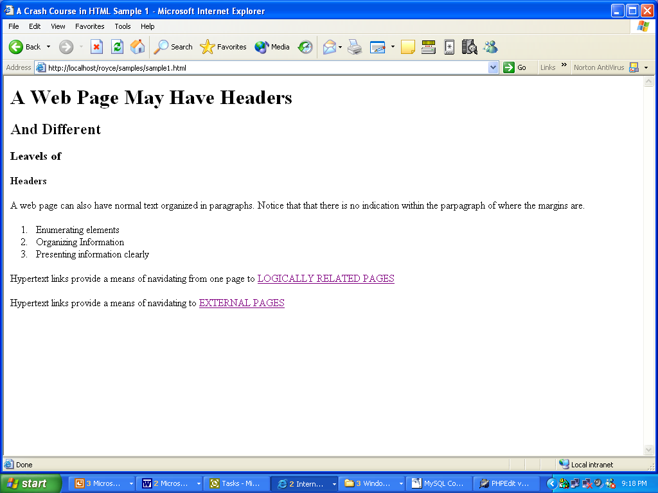

Slide 8
<HTML>
<HEAD>
<TITLE>A Crash Course in HTML Sample 1</TITLE></HEAD>
<BODY>
<H1>A Web Page May Have Headers</H1>
<H2>And Different</H2>
<H3>Levels of</H3>
<H4>Headers</H4>
<P>
A web page can also have normal text organized in paragraphs. Notice that that there is no indication within the paragraph of
where the margins are.
</P>
<OL>
<LI>
Enumerating elements
<LI>
Organizing Information
<LI>
Presenting information clearly
</OL>
<P>
Hypertext links provide a means of navigating from one page to <A HREF="sample2.html">LOGICALLY RELATED PAGES</A>
<BR>
<BR>
Hypertext links provide a means of navigating to <A HREF="http://www.creighton.edu/search.html">EXTERNAL PAGES</A>
</P>
</BODY>
</HTML>

Slide 9
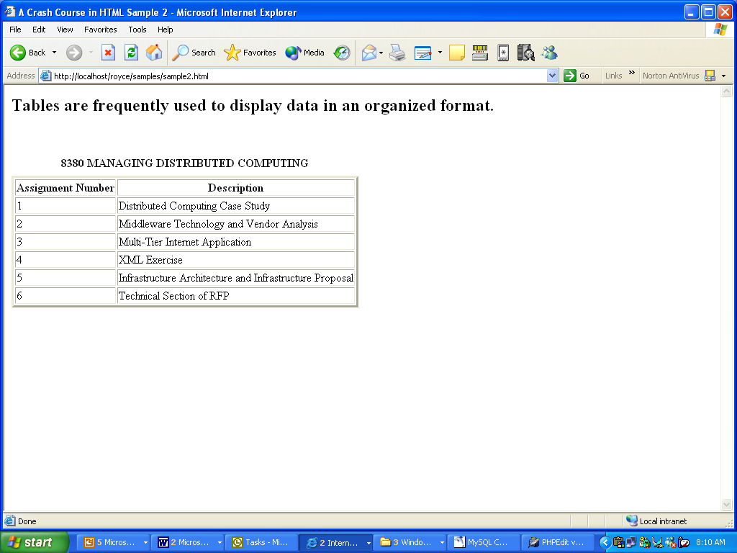

Slide 10
<HTML>
<HEAD>
<TITLE>A Crash Course in HTML Sample 2</TITLE></HEAD>
<BODY>
<H2>Tables are frequently used to display data in an organized format.</H2>
<BR>
<BR>
<TABLE border=3>
<CAPTION><B> 8380 MANAGING DISTRIBUTED COMPUTING </B></CAPTION>
<TR>
<TH>Assignment Number</TH>
<TH>Description</TH>
</TR>
<TR>
<TD>1</TD>
<TD>Distributed Computing Case Study</TD>
</TR>
<TD>2</TD>
<TD>Middleware Technology and Vendor Analysis</TD>
</TR>
</TR>
<TD>3</TD>
<TD>Multi-Tier Internet Application</TD>
</TR>
</TR>
<TD>4</TD>
<TD>XML Exercise</TD>
</TR>
</TABLE>
</BODY>
</HTML>

Slide 11
CSS (Cascading Style Sheet)
CSS is a style language that defines layout of HTML documents including fonts, colors, margins, height, width, etc…
Here is an example
default.html
<html>
<head>
<title>My document</title>
<link rel="stylesheet" type="text/css" href="style.css" />
</head>
<body>
<h1>My first stylesheet</h1>
</body>
</html>
style.css
body {
background-color: #33FF33;
}

Slide 12
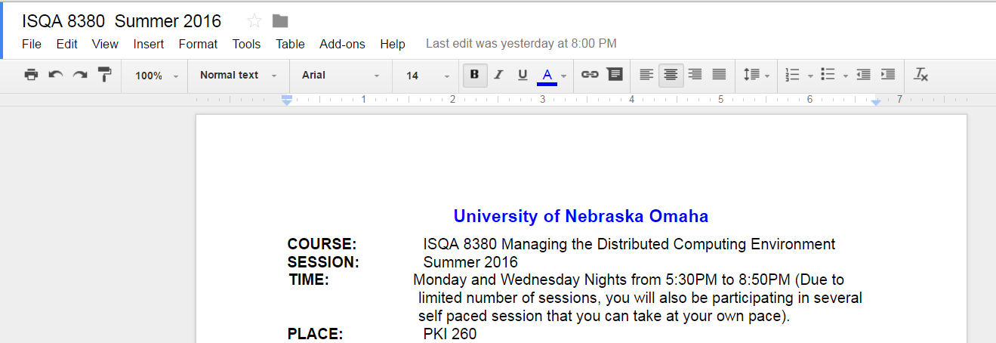
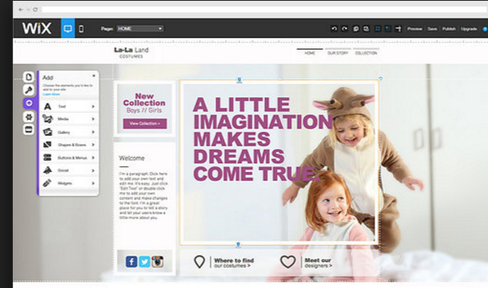
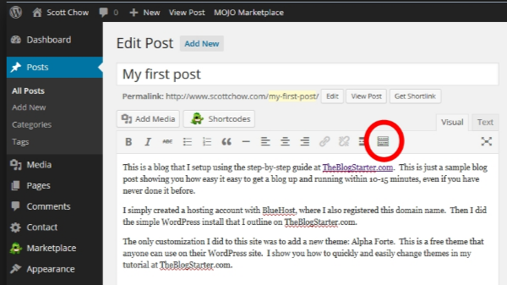
The “Editable Web” eliminates need for HTML/CSS for simple content sites
Wordpress, Drupal content management, Google docs sites like WIX creates the HTML/CSS and even JS for you!

Slide 13
Our focus is building custom, data driven web sites, similar to what you can expect in your ISQA 8950 Capstone Class
ODBC
Script
2
DB
variables
SQL
1
Browser
Web Server
3
App Server
4
DBMS
6
HTML
5
Data
Inter(-tra)net
The DYNAMIC Web – Application Server
Notes:
This diagram provides both a physical view (the hardware and networks) and a logical view (which processes run where).
Browser requests a page, which may have a special extension like .cfm or .pl to indicate that it is really a program rather than a page. If User is looking at a form, has provided some input, and clicked on 'submit', then the request will include variables in the form of attribute/value pairs
If the request is for a static page, the Web Server finds the page (images, etc.) and returns them as in the Basic Web. If the request references a script, the Web Server sends the Script along with any Variables to the Application Server.
The Application Server processes {interprets, invokes} the script.
Some scripts will request connections to the database and provide queries which are to be executed. The Application Server establishes the connection, sends the query, receives the results.
With the data results and the HTML skeleton provided by the script, the Application Server creates an HTML Page
The HTML page is sent back to the Web Server for delivery back to the browser

Slide 14
Submitting Input to the Server
Data are sent as
attribute-value pairs
with no inherent structure
or order
Lname=“Royce”
Fname=“George
Height=70 in.
Occupation=“CTO”
FavMusic=“Handel’s Messiah”
Inter(-tra)net
HTML
Notes:
When the variables are sent to the server, think of them as a set of attribute-value pairs. If I want a particular value, I will access it by asking for the value corresponding to a particular variable name. I won't get a structured array that I can access by providing an index value. I don’t access values by indicating that I want the third variable's value.
In this example I would be able to ask and receive an answer to the question "what is the value of 'Lname' or 'FavMusic'?" I would not be able to get an answer to the question "What is the value of the first variable?"

Slide 15
Application Server
A server (a process) providing a variety of services needed by applications, e.g.
Connectivity to the database & other information resources
Transaction management
User session management, keeping track of session state
Security functions
Load balancing, integration, fail-over
Application development environment
Our Python Django Application Server is on your machine and Heroku or PythonAnywhere
If you have not signed up for this site yet, please do.
Notes:
Delivering Web applications requires a Web application server in addition to the HTTP server used for static sites. Web application servers provide both the development tools and run-time platform for creating and deploying applications on the Web. Typically they offer a range of services including security and state management, as well as connectivity to database and other server technologies. Advanced servers also typically provide features such as native support for load balancing and fail over, interactive debugging, and integration with distributed object standards.

Slide 16
Web and Application Servers Work Together
ODBC
Script
2
DB
variables
SQL
1
Browser
Web Server
3
App Server
4
DBMS
6
HTML
5
Data
Inter(-tra)net
Notes:
This diagram provides both a physical view (the hardware and networks) and a logical view (which processes run where).
Browser requests a page, which may have a special extension like .cfm or .pl to indicate that it is really a program rather than a page. If User is looking at a form, has provided some input, and clicked on 'submit', then the request will include variables in the form of attribute/value pairs
If the request is for a static page, the Web Server finds the page (images, etc.) and returns them as in the Basic Web. If the request references a script, the Web Server sends the Script along with any Variables to the Application Server.
The Application Server processes {interprets, invokes} the script.
Some scripts will request connections to the database and provide queries which are to be executed. The Application Server establishes the connection, sends the query, receives the results.
With the data results and the HTML skeleton provided by the script, the Application Server creates an HTML Page
The HTML page is sent back to the Web Server for delivery back to the browser

Slide 17
Programming & Web Pages
Applications developer must create a separate page for each user activity
Applications developer must anticipate each sequence of user activities
Explicit coding of flow of control reminiscent of pre-GUI era...
Notes:
Because each page the user sees is divorced from the database when the user sees it, the application developer has to spend a great deal more effort managing the flow of data back and forth between the user and the database. No longer can I see a piece of data and change it without any further need for coding this functionality. Now, to permit a user to see a piece of data and change it, I need to create separate pages to see the data, request that it be changed, and make the change. The interface possibilities are much more cumbersome. Interface designer does not have scrollbars or navigation buttons provided by a wizard. Each skip to the next record requires an exchange with the database that must be planned for and supported.

Slide 18


Your Web Development Environment
Third Party API’s/ Web Services
like Yahoo Finance for a stock quote) and others.
Development Environment
Integration / Test Environment
Windows and Python Django App server and Database Development Environment
PyCharm (HTML/CSS/PHP Integrated Development Environment.
GitHub to manage code between environments
You will experience a realistic web development environment.
You need to demonstrate that you created your application and database in one environment and moved the application to an integration/test environment
There are videos to show you how to work with this environment approach and learn Django.

Slide 19
What is MVC?
Model represents the data model
“Manages behavior and data of the application domain”
View represents the screen(s) shown to the user
“Manages the graphical and/or textual output to the portion of the bitmapped display that is allocated to its application”
Controller represents interactions from the user that changes the data and the view
“Interprets the mouse and keyboard inputs from the user, commanding the model and/or the view to change as appropriate” (Burbeck)

Slide 20
How did it come about?
Presented by Trygve Reenskaug in 1979
First used in the Smalltalk-80 framework
Used in making Apple interfaces (Lisa and Macintosh)

Slide 21
How Does it Work?
User inputs a command e.g., HTTP GET, POST usually from a web page.
Controller handles input and updates model (which updates the database) or changes the view
View, which relies on model to show data to user, updates if necessary, on the next request
Rinse and Repeat

Slide 22
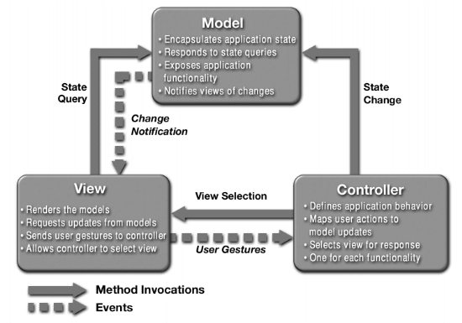
What is MVC?

Slide 23
Why Use M-V-C?
Provides a logical structure for heavily interactive system
Adheres to good engineering design principles and practices
Information hiding, less tight coupling, simplicity, etc.
Delegated control style

Slide 24
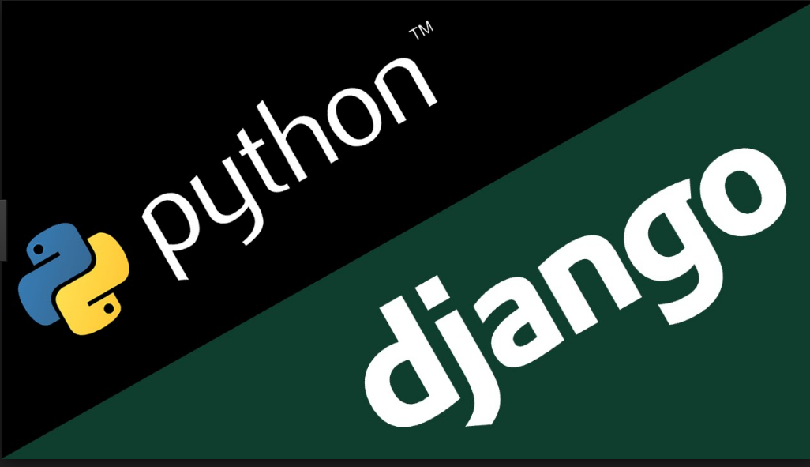

Django
Most popular full stack Python framework on Github.
Open source, rapid development framework for Python.
Features such as CRUD (create, read, update and delete) are security authentication and authorization are built into the framework.
It uses Model and View and is best to drive out the data model first which can is used by Django
Website: https://www.djangoproject.com/

Slide 25
How does Django Work?
Here’s what happens when a visitor lands on your Django page:
First, Django consults the various URL patterns you’ve created and uses the information to retrieve a view.
The view then processes the request, querying your database if necessary.
The view passes the requested information on to your template.
The template then renders the data in a layout you’ve created and displays the page.
“Getting Started with Django”, P. Statz, Wired. 2.15.2010

Slide 26
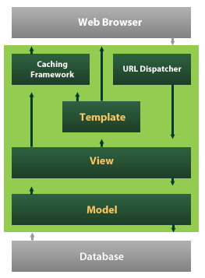
Model-View-Template

Slide 27
Major Features of Django
Complete Object Relational Mapper (ORM)
Built in form serialization and validation system
A serialization system that can produce and read XML and/or JSON representations of Django model instances
An interface to Python’s built-in unit test framework
A built in app server/web browser
An extensible authentication system
A dynamic and easy to use administrative interface.

Slide 28
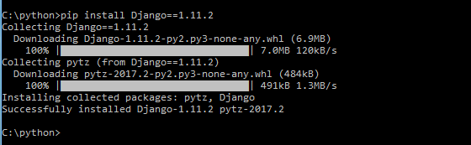
Activity: Build your Django Blog application.
You should have a system with python installed and in the path. If it is not installed go to https://www.python.org/downloads/release/python-361/
Be sure it is python 3.61
Create a directory for the blog project. I called it C:\python\blogger
Use the command line interface and run the following command:
pip install Django==1.11.2
You should see:

Slide 29
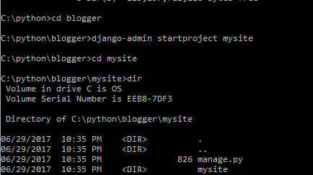
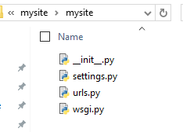
Create your Django project
With your chosen directory, run the following command to create a project called mysite:
django-admin startproject mysite

Slide 30
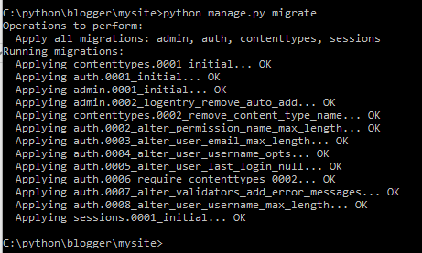
Time to do an initial migration and create the database
From the mysite project directory (must have manage.py in directory, issue this command:
python manage.py migrate
You should see:

Slide 31
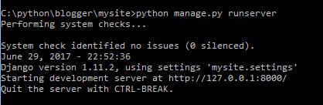
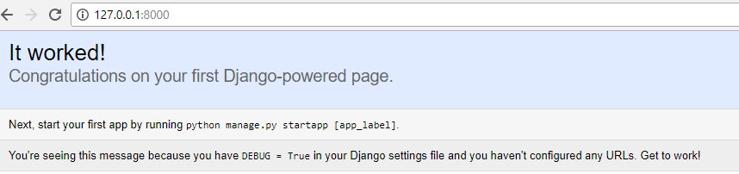
Run server to see initial output
Again, in the project directory, issue the following command: python manage.py runserver
Go to your browser and type in: http://127.0.0.1:8000/
You should see:

Slide 32
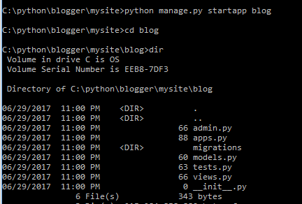
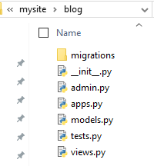
Now it is time to create the blog application
Again, in the project run the following command:
python manage.py startapp blog

Slide 33
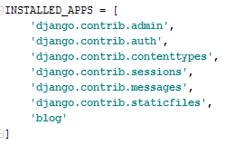

Now we need to edit the settings.py and add the blog application

Slide 34
Now we need to add the data model using Django Girls Site
https://tutorial.djangogirls.org/en/django_models/
from django.db import models
from django.utils import timezone
class Post(models.Model):
author = models.ForeignKey('auth.User')
title = models.CharField(max_length=200)
text = models.TextField()
created_date = models.DateTimeField(
default=timezone.now)
published_date = models.DateTimeField(
blank=True, null=True)
def publish(self):
self.published_date = timezone.now()
self.save()
def __str__(self):
return self.title

Slide 35
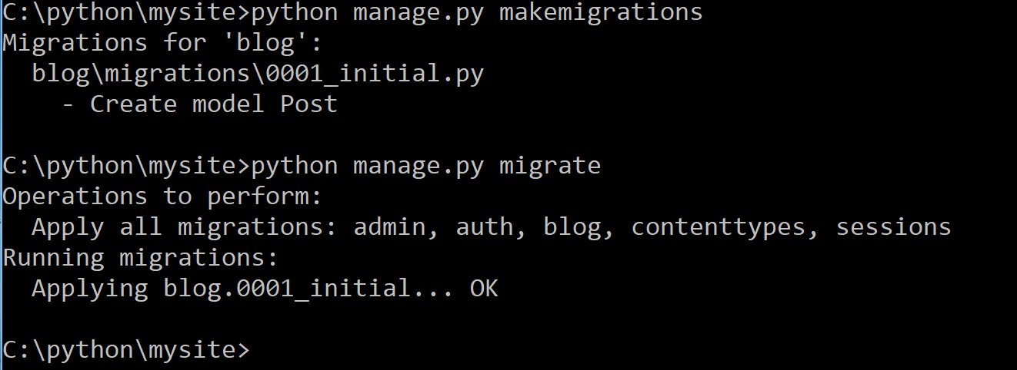
Next we makemigrations and migrate to update DB
python manage.py makemigrations
Python manage.py migrate
https://tutorial.djangogirls.org/en/django_models/

Slide 36
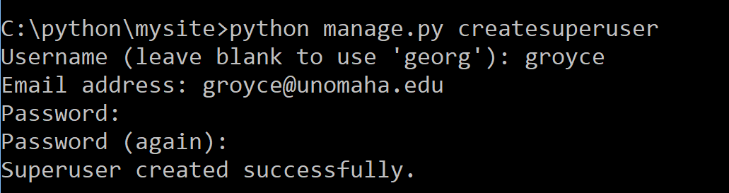
Now we add the following into admin.py and createsuperuser
from django.contrib import admin
from .models import Post
admin.site.register(Post)
createsuperuser

Slide 37
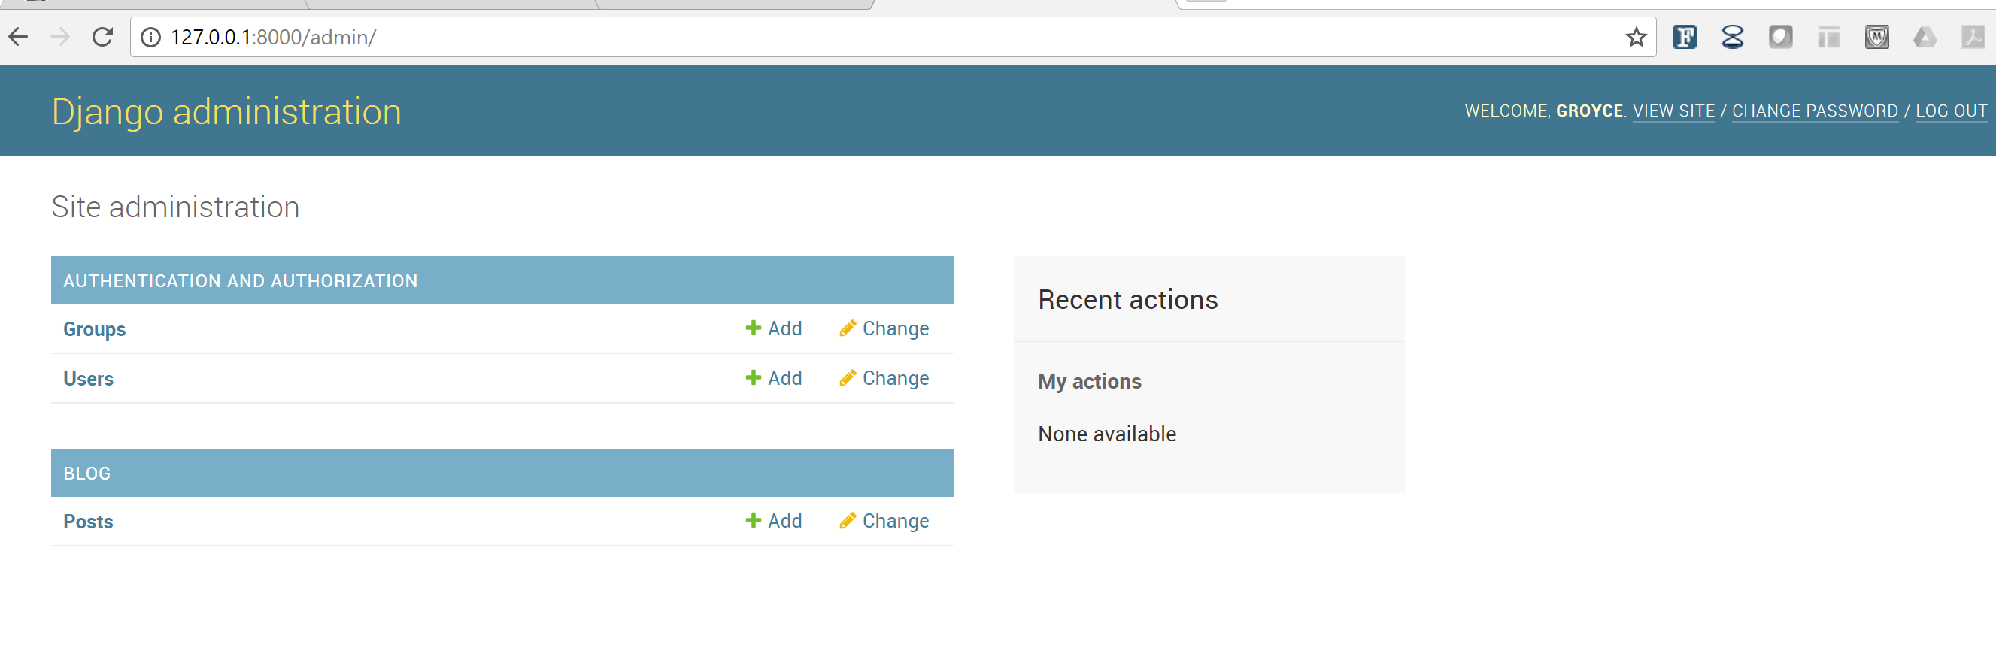
python manage.py runserver and type http://127.0.0.1:8000/admin/ in the browser
Do runserver so see the Admin Panel

Slide 38
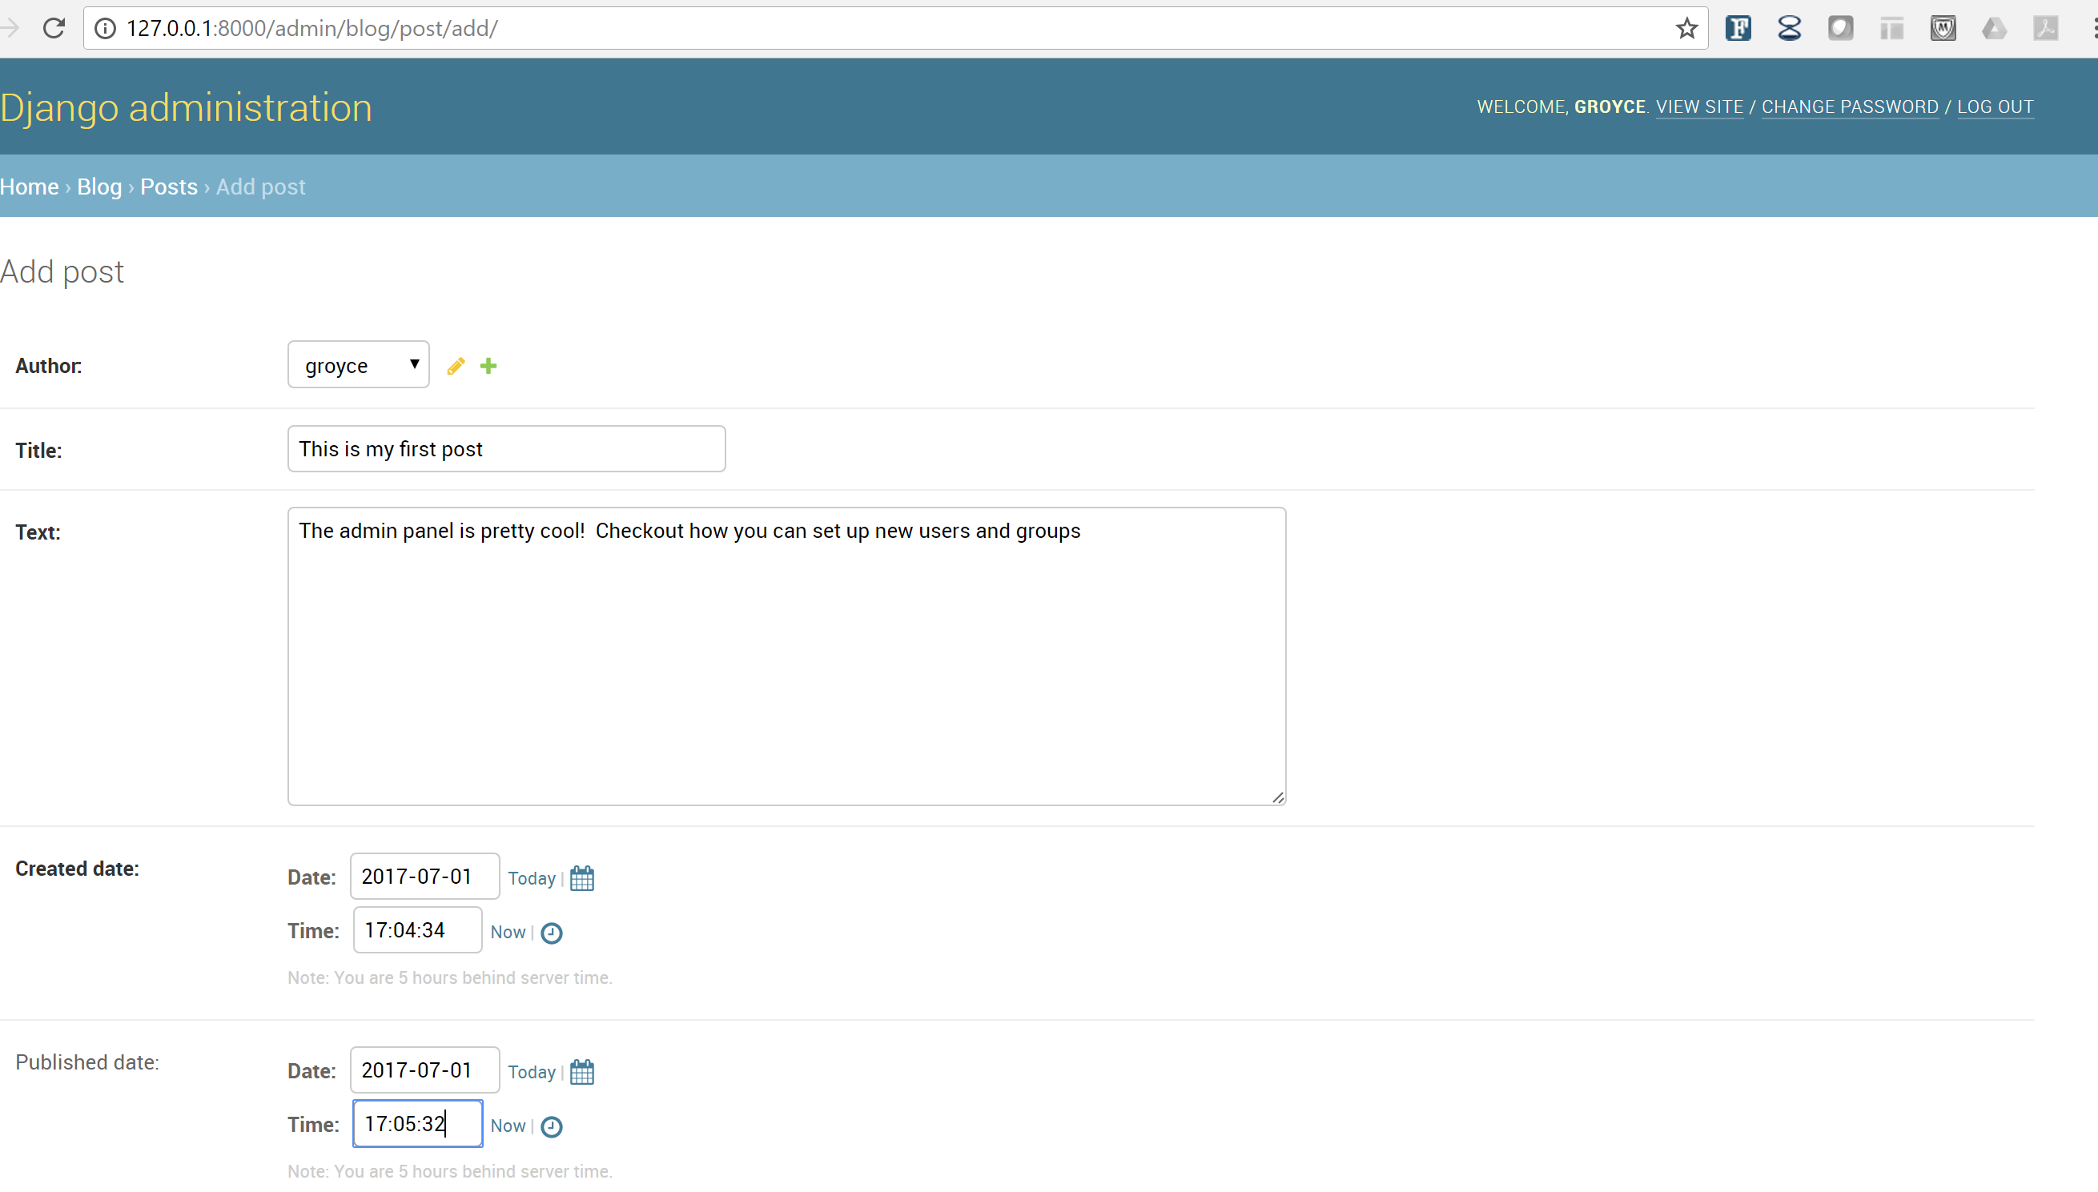
Finally add a couple of test posts

Slide 39
Managing Your Code with Git and Github
As you develop and update code, especially as a team in the Capstone class, you will need to learn how to use both Git and Github.
Assignment 1 and Assignment 4 code will be delivered to me by sharing your code with me on Github.
You are required to use Git on your PC or MAC to deploy your applications to Heroku. Obtain Git from:
https://git-scm.com/downloads
Obtain training on Git from CodeSchool and at BitBucket and other tutorial sites:
https://www.codeschool.com/courses/try-git
Github Training is found here:
https://help.github.com/categories/bootcamp/

Slide 40
Summary
HTML, CSS and JavaScript are used to compose the basic web pages we use everyday.
The Editable web makes it easy to create and main content pages on the web.
To add transactional capabilities to the web application servers and databases are required.
Application servers of PHP, Ruby, Python, Server Side JavaScript and other languages, .NET and Java are the primary application languages in use today.
M-V-C Architectural design pattern which works to separate data and UI for a more cohesive and modularized system
Model represents the data model
View represents the screen(s) shown to the user
Controller represents interactions from the user that changes the data and the view
Django is a popular MVT (Model View Template) framework.

